Slide 1
Software Design
Instructor: Mr. Nicholas Mendez

Slide 2
Outline
What is Software Design
Concepts
Considerations
Design Principles

Slide 3
“Software design is both a process of defining, the architecture, components, interfaces, and other characteristics of a system or component and the result of that process.”
-IEEE
Notes:
TLDR; the decisions made which resulted in your final implementation of a solution. Good design -> sophistication -> purpose

Slide 4
Software Design Concepts

Slide 5
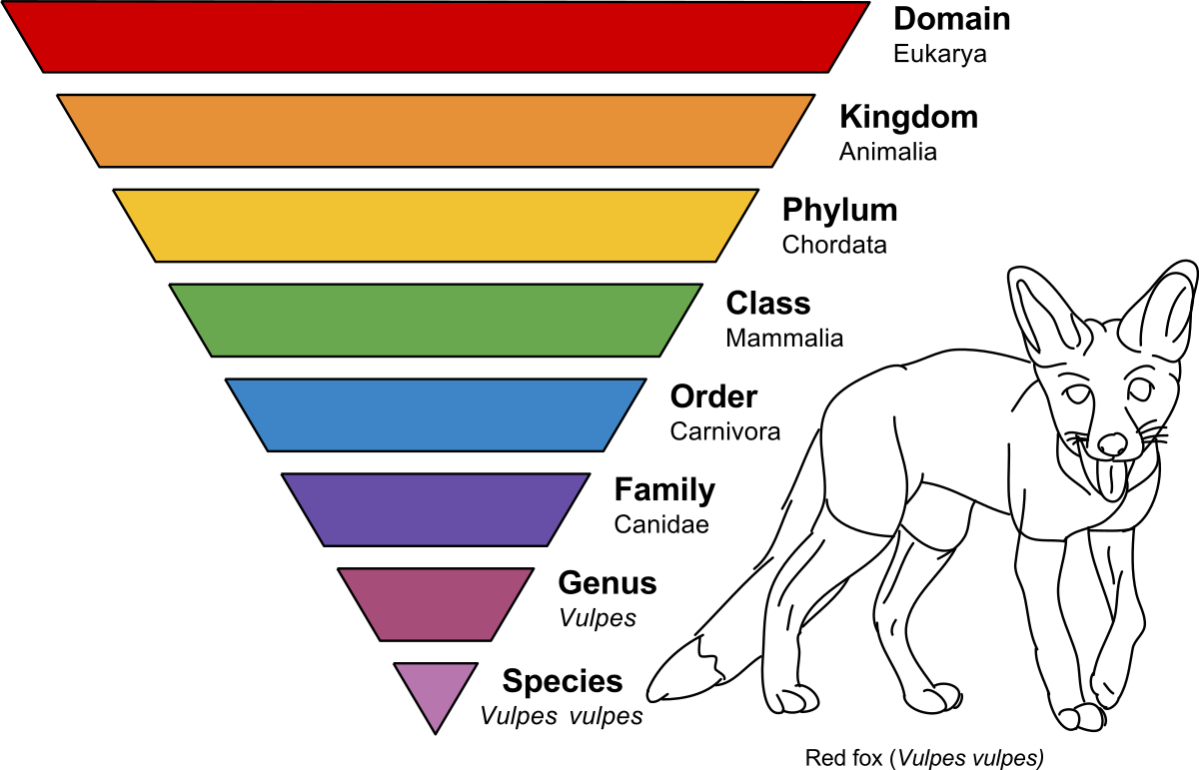
Abstraction
In software engineering and computer science, abstraction is a technique for arranging complexity of computer systems. It works by establishing a level of complexity on which a person interacts with the system, suppressing the more complex details below the current level.
Generalization:
Removing details
from Specific to General
Grizzly Bear -> -> Mammals -> Vertebrates -> Animals
De-duplicating Code
Creating an interface
moving common details to parent class
Moving redundant code into function
https://computersciencewiki.org/index.php/Abstraction#cite_note-1

Slide 6
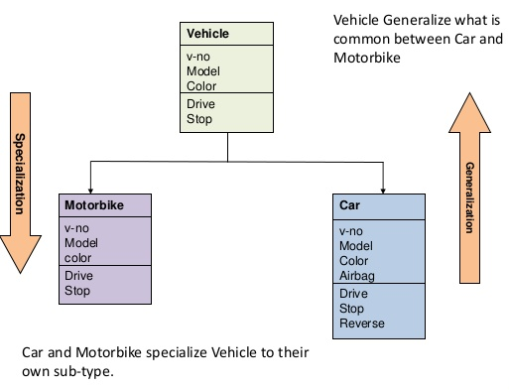
2. Refinement
The opposite of abstraction
Specialization
Adding Detail
From general to specific
Animal -> vertebrates -> Mammals
-> Ursidae -> Grizzly Bear
Extending class
overriding a parent method
Creating a function to fit a more specific use case
https://pdfs.semanticscholar.org/e82e/2f8a7d607f372534c61cb676e78989cfcfee.pdf

Slide 7
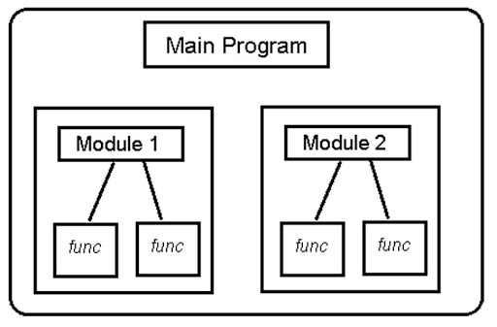
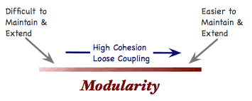
3. Modularity
Splitting up an implementation into logically separate components
Components should be independent
Modular code bases are easier to manage
Reduces coupling between functionalities

Slide 8
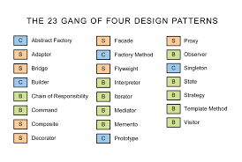
4. Patterns
Patterns are typical solutions to common problems
Each pattern is like a blueprint that you can customize to address a problem in your code
Types
Code Patterns
Design Patterns
Architectural Patterns
Cloud Patterns
Patterns convey the essence of a proven design solution

Slide 9
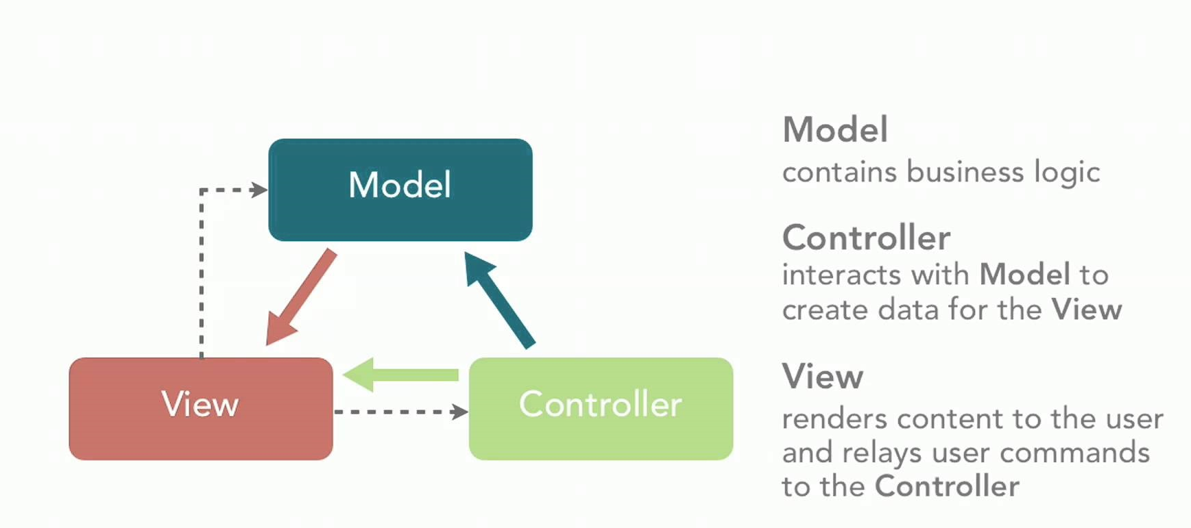
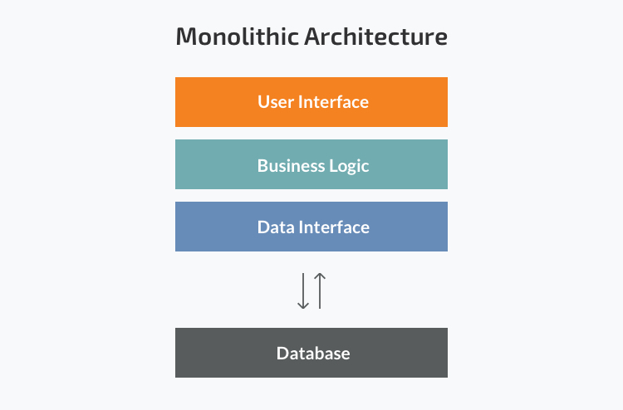
5. Software Architecture Patterns
The high level structural patterns of software components
Examples
Model View Controller
Flux
Layered
Monolithic
Peer to Peer
Event Driven
Microservices
Pipes and Filters
Service Oriented
REST
Client Server
https://medium.com/@madasamy/flux-vs-mvc-design-pattern-de134dfaa12b#:~:text=In%20Web%20Application%20development%20MVC%20is%20an%20design%20pattern%20for,focuses%20on%20unidirectional%20data%20flow.&text=MVC.

Slide 10
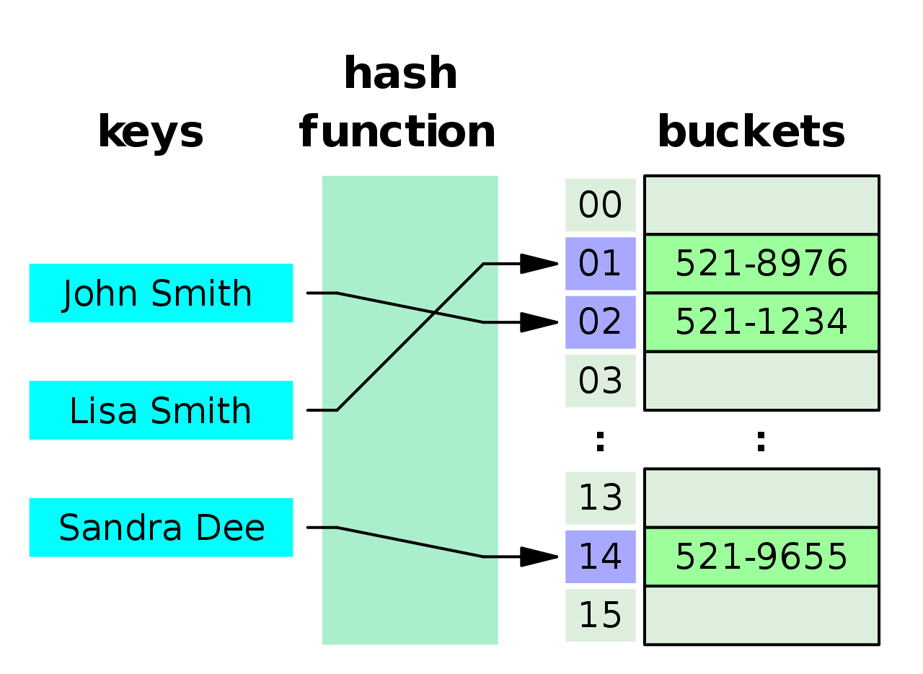
6. Data Structures
The model of the logical relationship among data elements
Data structures are optimized for efficient access and modification
Crucial in the design of efficient algorithms
Single and Multi-dimensional Arrays
Object literals/ Dictionaries
Hash Tables
Binary Trees
Graphs
Stacks
Queues

Slide 11
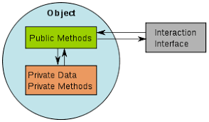
7. Information Hiding
Information in one module should not be accessible to modules which do not rely on it
Reduces the likelihood of side effects
Enforces communication through controlled interfaces
Discourages global data
Higher software quality
Achieves Encapsulation: Hiding of state within a class to prevent unauthorized access

Slide 12
8. Functional Independence
Single minded functions
Cohesion: The degree of focus a module gives to single task.
When a module performs a set of tasks which are all related to each other.
When the tasks in a module must be executed within the same timeframe
When the tasks within a module must be executed in a particular order
When the tasks of a module focus on one area of a data structure.
Coupling: refers to the interdependency between two more more modules.
Sharing global data
Passing data between each other
Passing control flags
Using data information handled by another modules
High cohesion and low coupling
A benefit of effective modular design

Slide 13

9. Refactoring
Reorganizing code to improve design but retain functionality
Aims to make code more readable
Implementation that can be changed easily without breaking is an indication of clean flexible code.
Fixing and identifying code smells
Applying well established design patterns

Slide 14
Design Considerations

Slide 15
Design Considerations/ Quality Metrics
Maintainability
Extensibility
Fault Tolerance
Modularity
Reusability
Robustness
Security
Portability
Scalability
Privacy
Performance
Accessibility
Reliability
Usability
Functionality
Testability
https://docs.google.com/presentation/d/14ST-Z5QE15uw-oprOXNgESR0XCFInILsgmAz7xxa5sI/edit?usp=sharing

Slide 16
Design Principles

Slide 17
Design Principles
SOLID principles
S - Single Responsibility
O - Open Close
L - Liskov Substitution
I - Interface Segregation
D - Dependency Inversion
KISS: Keep It Stupidly Simple
DRY: Don’t Repeat Yourself
YAGNI: You ain’t gonna need it
Separation of Concerns: A system should be comprised of sparable sections where each address a concern in the solution.
Code Smells

Slide 18
Code Rot
As the requirements for software change, and as the software mature
without careful considerations for the design the software can begin
to “rot”. This means that developers find that the code/software is
increasingly difficult to maintain. The following properties were
described by Mr Martin in his publications “The clean coder” & “Clean”
Rigidity: Small changes cause the entire system to be refactored or
rebuilt
Fragility : Changes to one module causes other unrelated modules
to change
Immobility: Inability to reuse components in new environments
Viscosity: Software takes longer time to make changes as software
matures. (simple functionality require changes in multiple places/levels of the

Slide 19
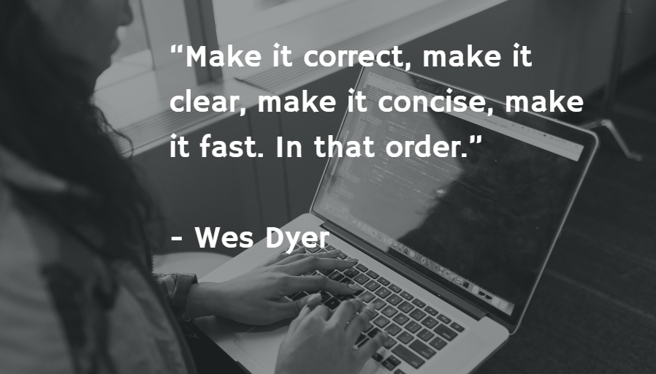

Slide 20
SOLID Principles

Slide 21
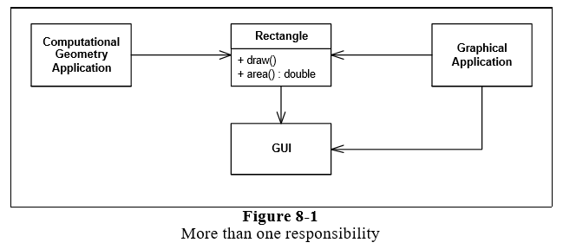
Software Design Principles - SRP
Single Responsibility Principle: Every software module (class, functions) should have only one reason to change (responsibility).
If a class has more than one responsibility, then the responsibilities become coupled.
Changes to one responsibility may impair or inhibit the class’ ability to meet the others.
This kind of coupling leads to fragile designs that break in unexpected ways when changed.

Slide 22
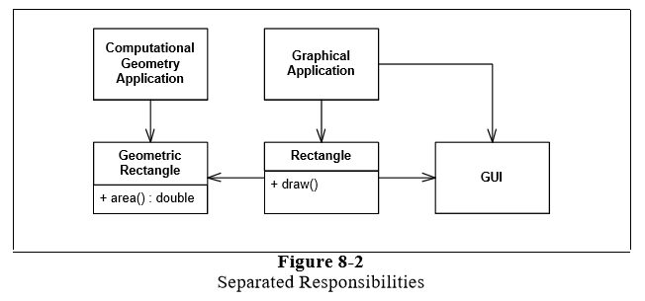
Software Design Principles - SRP
Notes:
This design violates the SRP. The Rectangle class has two responsibilities.
The first responsibility is to provide a mathematical model of the geometry of a rectangle.
The second responsibility is to render the rectangle on a graphical user interface.
The violation of SRP causes several nasty problems. Firstly, we must include the GUI in the computational geometry application.
In .NET the GUI assembly would have to be built and deployed with the computational geometry application. Secondly, if a change to the Graphical Application causes the Rectangle to change for some reason, that change may force us to rebuild, retest, and redeploy the ComputationalGeometryApplication.
If we forget to do this, that application may break in unpredictable ways.

Slide 23
Software Design Principles - SRP
This design violates the SRP. The Rectangle class has two responsibilities.
The first responsibility is to provide a mathematical model of the geometry of a rectangle.
The second responsibility is to render the rectangle on a graphical user interface.
The violation of SRP causes several nasty problems.
Firstly, we must include the GUI in the computational geometry application. The GUI assembly would have to be built and deployed with the computational geometry application.
Secondly, if a change to the GraphicalApplication causes the Rectangle to change for some reason, that change may force us to rebuild, retest, and redeploy the ComputationalGeometryApplication.
If we forget to do this, that application may break in unpredictable ways.
Notes:
This design violates the SRP. The Rectangle class has two responsibilities.
The first responsibility is to provide a mathematical model of the geometry of a rectangle.
The second responsibility is to render the rectangle on a graphical user interface.
The violation of SRP causes several nasty problems. Firstly, we must include the GUI in the computational geometry application.
In .NET the GUI assembly would have to be built and deployed with the computational geometry application. Secondly, if a change to the GraphicalApplication causes the Rectangle to change for some reason, that change may force us to rebuild, retest, and redeploy the ComputationalGeometryApplication.
If we forget to do this, that application may break in unpredictable ways.

Slide 24
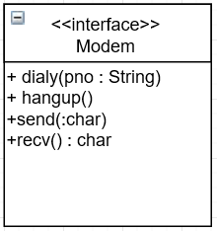
Software Design Principles - SRP
If, on the other hand, the application is not changing in ways that cause the two responsibilities to change at different times, then there is no need to separate them. Indeed, separating them would smell of Needless Complexity. There is a corollary here. An axis of change is only an axis of change if the changes actually occur. It is not wise to apply the SRP, or any other principle for that matter, if there is no symptom

Slide 25
Software Design Principles - OCP
Open Close Principle: Software entities should be open for extension but closed for modifications.
When a single change to a program results in a cascade of changes to dependent modules, that program exhibits the undesirable attributes that we have come to associate with “bad” design. The program becomes fragile, rigid, unpredictable and non reusable. The open-closed principle attacks this in a very straightforward way. It says that you should design modules that never change. When requirements change, you extend the behavior of such modules by adding new code, not by changing old code that already works.

Slide 26
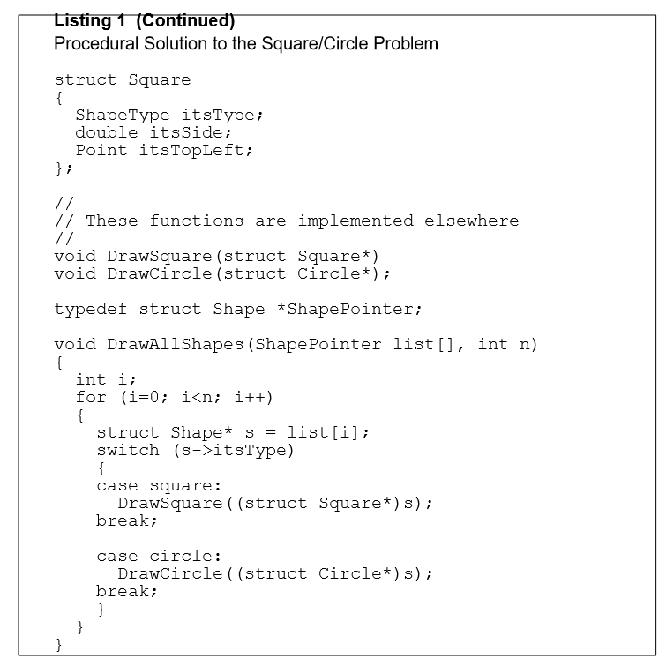
Software Design Principles - OCP

Slide 27
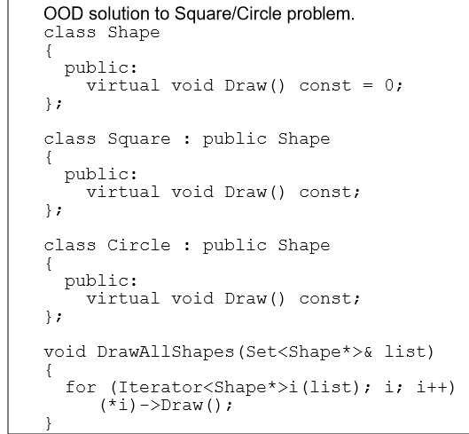
Software Design Principles - OCP
Note that if we want to extend the behavior of the DrawAllShapes function in to draw a new kind of shape, all we need do is add a new derivative of the Shape class. The DrawAllShapes function does not need to change. Thus DrawAllShapes conforms to the open-closed principle. Its behavior can be extended without modifying it.

Slide 28
Software Design Principles - OCP
Since closure cannot be complete, it must be strategic. That is, the designer must choose the kinds of changes against which to close his design. This takes a certain amount of prescience derived from experience. The experienced designer knows the users and the industry well enough to judge the probability of different kinds of changes. He then makes sure that the open-closed principle is invoked for the most probable changes.
Example Example Refactor
NB: Take note of the following sections in the handout provided:
Heuristics and conventions

Slide 29
The Liskov Substitution Principle (LSP)
Liskov's Substitution Principle states that if a program module is using a Base class, then the reference to the Base class can be replaced with a Derived class without affecting the functionality of the program module.
DrawShape is badly formed because it must know about every possible derivative of the shape class.
Imagine that this application works well, and is installed in many sites. As is the case with all successful software, as its users’ needs change, new functions are needed. Imagine that one day the users demand the ability to manipulate squares in addition to rectangles.
Example

Slide 30
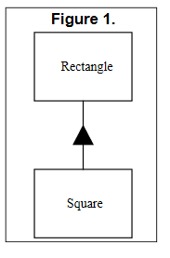
The Liskov Substitution Principle (LSP)
Clearly, the programmer made this very reasonable assumption. Passing a Square to functions whose programmers made this assumption will result in problems.
Therefore, there exist functions that take pointers or references to Rectangle objects but cannot operate properly upon Square objects. These functions expose a violation of the LSP. The addition of the Square derivative of Rectangle has broken these function; and so the Open-Closed principle has been violated

Slide 31
Software Design Principles - ISP
Interface Segregation Principle: Clients should not be forced to implement interfaces they don’t use. Furthermore many specific interfaces are better than one general purpose interface.
This principle deals with the disadvantage of fat interfaces.
The ISP acknowledges that there are objects that require non-cohesive interfaces; however it suggests that clients should not know about them as a single class. Instead, clients should know about abstract base classes that have cohesive interfaces. Some languages refer to these abstract base classes as “interfaces”, “protocols” or “signatures”.

Slide 32
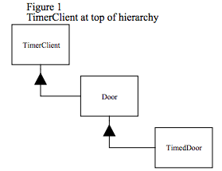
Software Design Principles - ISP
How can we get the TimerClient class to communicate with the TimedDoor class so that the code in the TimedDoor can be notified of the timeout?
There are several alternatives. Figure 1 shows a common solution. We force Door, and therefore TimedDoor, to inherit from TimerClient. This ensures that TimerClient can register itself with the Timer and receive the TimeOut message

Slide 33
Software Design Principles - ISP
Although this solution is common, it is not without problems. Chief among these is that the Door class now depends upon TimerClient. Not all varieties of Door need timing.
Indeed, the original Door abstraction had nothing whatever to do with timing. If timing free derivatives of Door are created, those derivatives will have to provide nil implementations for the TimeOut method.
Moreover, the applications that use those derivatives will have to include the definition of the TimerClient class, even though it is not used.

Slide 34
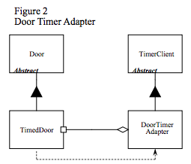
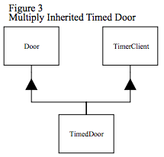
Software Design Principles - ISP
Some possible solutions for the archiving ISP includes:
Separation through delegation Separation through multiple inheritance

Slide 35
Software Design Principles - DIP
Dependency Inversion Principle:
a) High level modules should not depend on lower level modules. Rather both should depend on abstractions
Or
b) Abstractions should not depend upon details. Details should depend upon abstractions

Slide 36
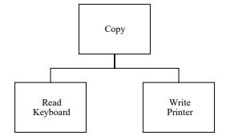
Software Design Principles - DIP
Consider a simple program that is charged with the task of copying characters typed on a keyboard to a printer.
The body of that loop calls the “Read Keyboard” module to fetch a character from the keyboard, it then sends that character to the “Write Printer” module which prints the character.
However, the “Copy” module is not reusable in any context which does not involve a keyboard or a printer. This is a shame since the intelligence of the system is maintained in this module. It is the “Copy” module that encapsulates a very interesting policy that we would like to reuse.

Slide 37
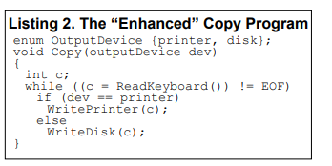
Software Design Principles - DIP
We could add an ‘if’ statement to its policy and have it select between the “Write Printer” module and the “Write Disk” module depending upon some kind of flag. However this adds new interdependencies to the system.
As time goes on, and more and more devices must participate in the copy program, the “Copy” module will be littered with if/else statements and will be dependent upon many lower level modules. It will eventually become rigid and fragile

Slide 38
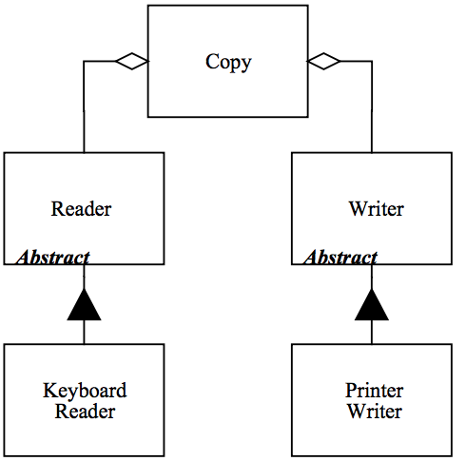
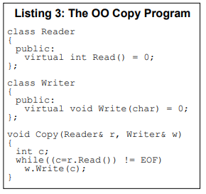
Software Design Principles - DIP
the dependencies have been inverted; the “Copy” class depends upon abstractions, and the detailed readers and writers depend upon the same abstractions.
Now we can reuse the “Copy” class, independently of the “Keyboard Reader” and the “PrinterWriter”. We can invent new kinds of “Reader” and “Writer” derivatives that we can supply to the “Copy” class.

Slide 39
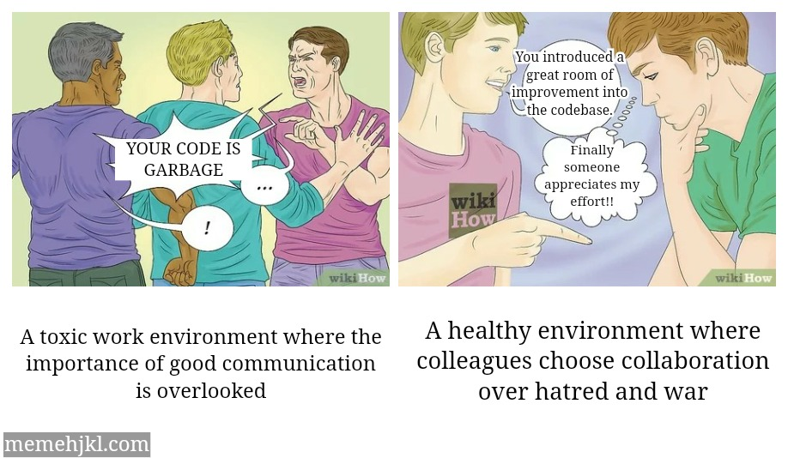
Write better code

Slide 40
References
https://www.tutorialride.com/software-engineering/software-process-designing-concepts.htm
https://www.tutorialspoint.com/software_engineering/software_design_basics.htm
https://en.wikipedia.org/wiki/SOLID

